Slide 1

RESTURNAT MANGMENT
SYSTEM
DALLA3 KERSHAK UNIVERSITY FOOD APPLICATION
DR. SARAH NAIEM
DR. DOAA MOHEY ELDIN
CODE: INF2201

Slide 2
PROJECT OVERVIEW
Purpose of the System:
To digitalize and streamline the dining experience within the university food court, integrating multiple vendors into a single unified platform.
Main Objectives:
  Centralize order management for all campus food vendors.
  Provide accurate wait times and live queue tracking.
  Enhance student experience with a unified payment and loyalty system.
Problems Solved:
  Long, unorganized waiting lines between classes.
  Inefficient manual order taking and lost paper tickets.
  Lack of data tracking for vendor performance and popular items.

Slide 3
DATABASE DESIGN
Main Tables:
Users, FoodVendors, MenuItems, FoodCourtTables, Orders, OrderDetails, Payments.
Relationships:
  1-to-Many: Users ➔ Orders, FoodVendors ➔ MenuItems, Orders ➔ OrderDetails
  1-to-1: Orders ➔ Payments
Keys & Constraints:
  Primary Keys (PK): Unique IDs such as OrderID, UserID, MenuID
  Foreign Keys (FK): Ensure referential integrity between tables
Normalization:
Designed up to 3NF to eliminate data redundancy and maintain a scalable structure.

Slide 4
SYSTEM FEATURES
Our system provides modern capabilities for campus dining:
  Online Ordering: Support for Dine-in, Takeaway, and Campus Delivery.
  Queue Management: Live status updates (Waiting ➔ Preparing ➔ Ready).
  Estimated Waiting Time: Auto-calculated based on prep times.
  Payment System: Supports Cash, Credit Card, and Student Card.
  Loyalty Points: Earn and redeem points.
  Table Management: Tracks table status and occupancy.

Slide 5
TRIGGERS (AUTOMATED LOGIC)
The database uses triggers to automate workflows:
  Automatic Table Status Update
  Automatically changes table status between Occupied and Available.
  Queue Number Generation
  Generates queue numbers such as Q001.
  Automatic Total Calculations
  Calculates SubTotal, TotalAmount, and waiting time automatically.
  Loyalty Points Automation
  Adds loyalty points after successful payment completion.

Slide 6
STORED PROCEDURES
The project includes reusable stored procedures:
  Process Order (sp_ProcessFoodCourtOrder)
  Handles order creation and inserts order details.
  Complete Payment (sp_CompletePayment)
  Processes payments and updates order state.
  Cancel Order (sp_CancelOrder)
  Cancels the order and updates queue status.
  Redeem Loyalty Points (sp_RedeemLoyaltyPoints)
  Applies discounts using loyalty points.

Slide 7
ENEFITS OF THE SYSTEM:
FUTURE IMPROVEMENTS:
  Faster service and reduced congestion.
  Automated order and payment tracking.
  Reliable and scalable database infrastructure.
  Mobile Application Development
  AI-based food recommendations

Slide 8
SQL ANALYSIS QUERIES
The system provides business intelligence using SQL analysis queries:
  Daily Revenue Reports
  Calculates daily profits and revenue.
  Popular Dishes
  Displays the most ordered items.
  Vendor Statistics
  Analyzes vendor sales and performance.
  Orders Analysis
  Tracks cancellations, active queues, and order statistics.

Slide 9
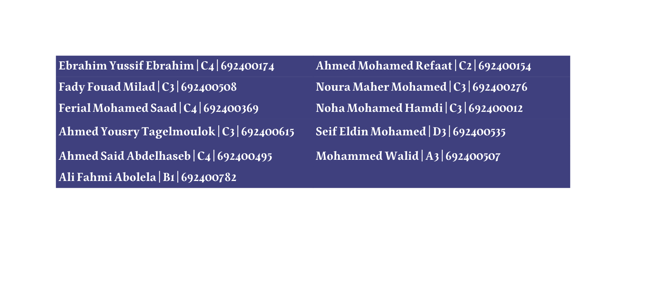
THANK YOU
WE WOULD LIKE TO SINCERELY THANK DR. SOHA SAFWAT ,DR. SARAH NAIEM AND DR. DOAA MOHEY ELDIN FOR THEIR VALUABLE SUPPORT AND GREAT EFFORTS THROUGHOUT OUR PROJECT.
YOUR GUIDANCE AND ENCOURAGEMENT MEANT A LOT TO US AND TRULY MADE A SIGNIFICANT DIFFERENCE.
OUR TEAM:

